Slide 1


SHOPSY
End-to-End E-Commerce Data Science Analysis and Machine Learning on Shopsy Product Data
SUBHASHINI.R
AUGUST 2025
DADS

Slide 2


SHOPSY
PROJECT OVERVIEW
This capstone project focuses on analyzing real-world
e-commerce product data scraped from the Shopsy website. The objective is to understand product trends, customer preferences, and performance patterns using data science techniques. The project covers the complete data science lifecycle, including data collection, cleaning, storage, exploratory analysis, unsupervised learning, supervised learning, and hyperparameter tuning to derive actionable business insights.

Slide 3
PROBLEM STATEMENT
SHOPSY
Shopsy provides extensive product data, but it is available in raw and unstructured form, making analysis challenging. This project scrapes and structures Shopsy product data and applies machine learning to uncover trends, classify products, and support data-driven product and marketing decisions.

Slide 4
DATA COLLECTION BY WEB SCRAPING
SHOPSY
Source:
Shopsy E-Commerce Website
Tools & Technologies
Python
Beautiful Soup / Requests
Pandas
Data Scraped
Product Name
Price
Category
Ratings
Number of Reviews
The data was scraped ethically while respecting website structure and usage policies, and stored in CSV format for further processing.

Slide 5
SHOPSY
DATA CLEANING & PREPROCESSING
After loading the scraped data into a Pandas Data Frame, the following steps were performed:
Handled missing values and inconsistent records
Removed duplicate and irrelevant entries
Standardized currency symbols and numerical formats
Converted text data to consistent casing

Slide 6
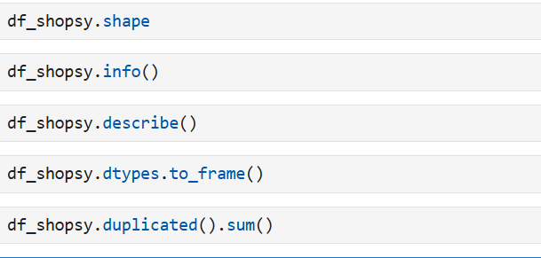
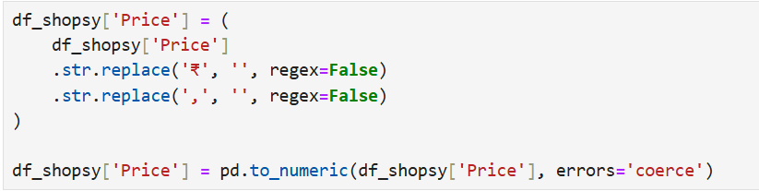
SHOPSY
DATA CLEANING

Slide 7
SHOPSY
Exploratory Data Analysis(EDA)
Performed Exploratory Data Analysis (EDA) to study:
Price distribution
Rating trends
Category-wise product distribution
Review count patterns
EDA helped to identify outliers, popular categories, and highly rated products.

Slide 8
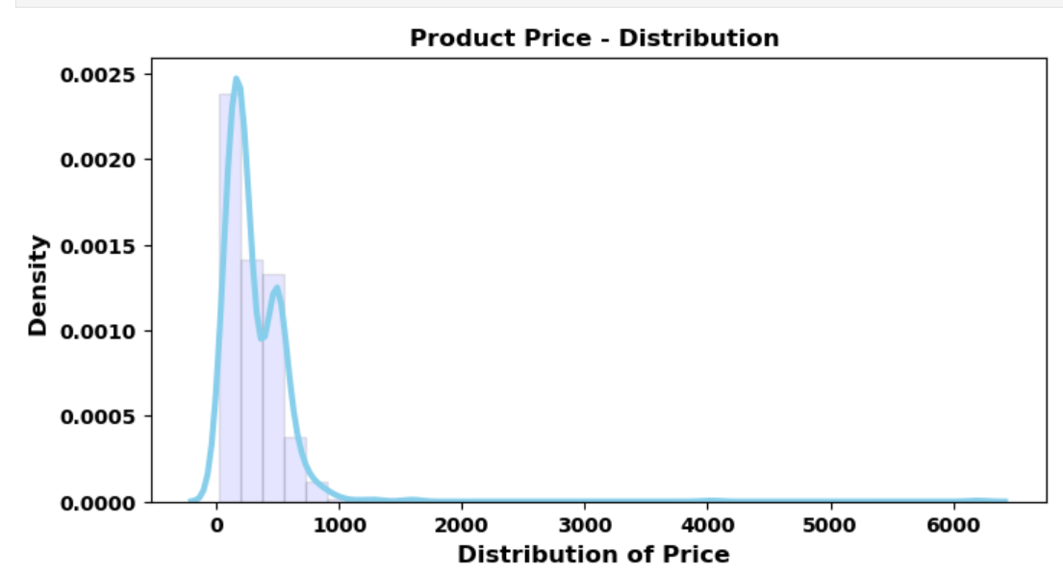
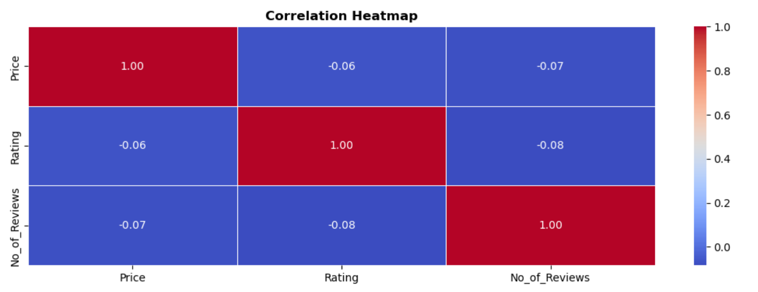
SHOPSY
Price Distribution
Correlation Heatmap

Slide 9
DATA STORAGE
A relational database was created using SQLAlchemy
Cleaned data was stored in structured tables
Enabled efficient querying and reuse of data for modeling
SHOPSY

Slide 10
SHOPSY
UNSUPERVISED LEARNING (Clustering)
Techniques Used
K-Means Clustering
Process
Selected relevant numerical features
Tested multiple cluster values using the Elbow Method
Assigned cluster labels to each product
Outcome
Grouped similar products based on price, ratings, and reviews
Helped identify premium, mid-range, and budget product clusters

Slide 11
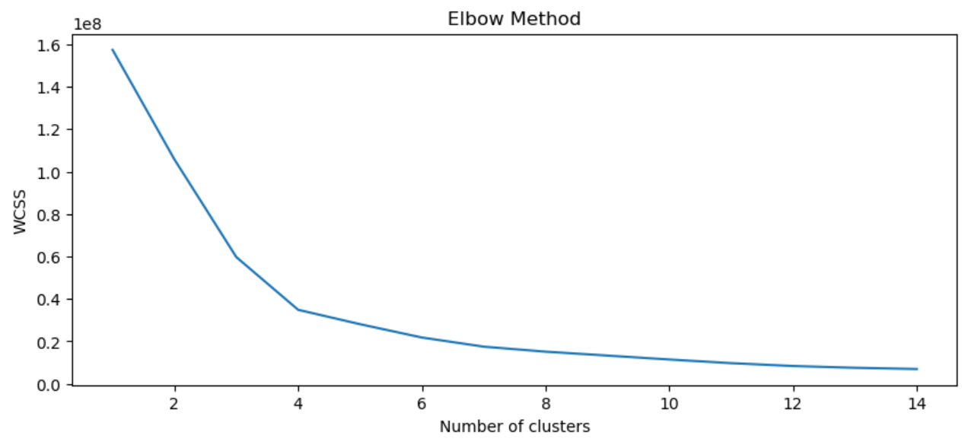
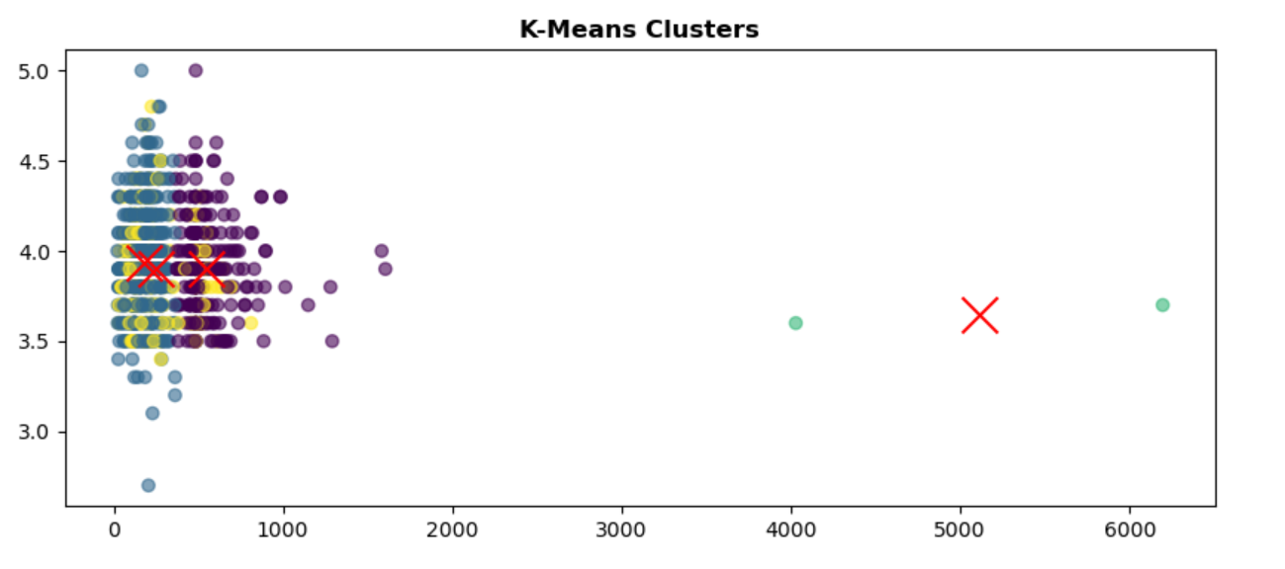
SHOPSY

Slide 12
SUPERVISED LEARNING
Multiple classification models were implemented to predict product categories or labels.
Models Used
Logistic Regression
Support Vector Machine (SVM)
k-Nearest Neighbors (k-NN)
Random Forest
XGBoost
SHOPSY

Slide 13
SHOPSY
SUPERVISED LEARNING
Evaluation Metrics
Accuracy
Precision
Recall
F1 Score
Random Forest performed best initially with ~93% accuracy.

Slide 14
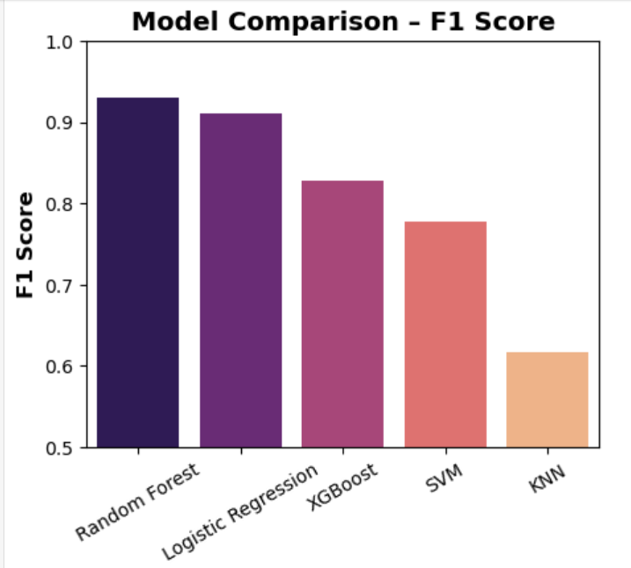
SHOPSY
MODEL COMPARISON

Slide 15
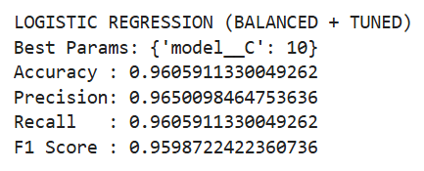
SHOPSY
HYPERPARAMETER TUNING
Accuracy: ~96%
F1 Score: ~96%
Precision & Recall well-balanced
The tuned Logistic Regression outperformed complex models while remaining interpretable and efficient.

Slide 16
SHOPSY
INSIGHTS
Proper data balancing and tuning improved model performance more than model complexity
Logistic Regression proved ideal due to:
High accuracy
Interpretability
Faster training and deployment
Shopsy product data shows strong linear patterns. Ratings and review counts significantly influence product classification.

Slide 17
SHOPSY
CONCLUSION
This project successfully demonstrates an end-to-end data science workflow using real-world data scraped from Shopsy. By combining web scraping, data analysis, clustering, supervised learning, and hyper parameter tuning, meaningful insights were extracted to support business decisions. The final tuned Logistic Regression model achieved the best performance and was selected for deployment.

Slide 18
Thank You !

